Slide 1

Project CV 3:
Self-Driving Car
Kelompok CV A & C
Amar Ma'ruf
Bayuzen Ahmad
Benedictus Dikha Arianda
Dika Mahendra
Elsa Nurul Hidayah
Fariz Rachman Hadi
Fatah Abdul Jalil
Haris Raharjo Putro
Kio Sato
M. Andhika Dwiki Nugraha
Mahdia Aliyya Nuha Kiswanto
Michael Andrian
Moch Ardhi Kurniawan
Muhammad Bramansyah
Muhammad Fatih Zuhdy

Slide 2
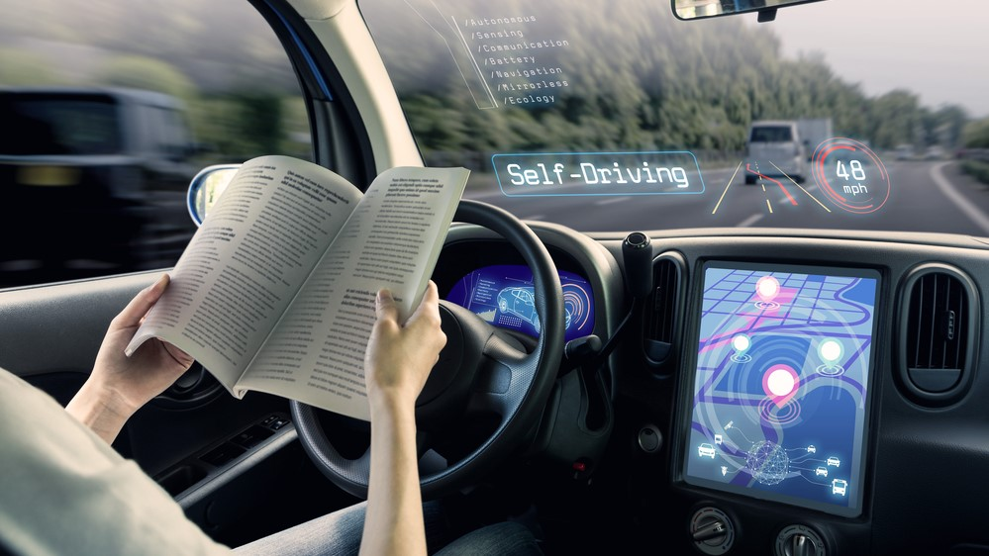
Background: Self-Driving Car
One of the big problems in urban areas is traffic congestion which can cause accidents. One of the factors that played a big role in this incident was the driver's negligence.
According to WHO, the traffic system is one of the most complex and dangerous systems that we face almost every day.
For this reason, it is hoped that the existence of a self-driving car using AI technology can be a solution to improve driving safety.

Slide 3

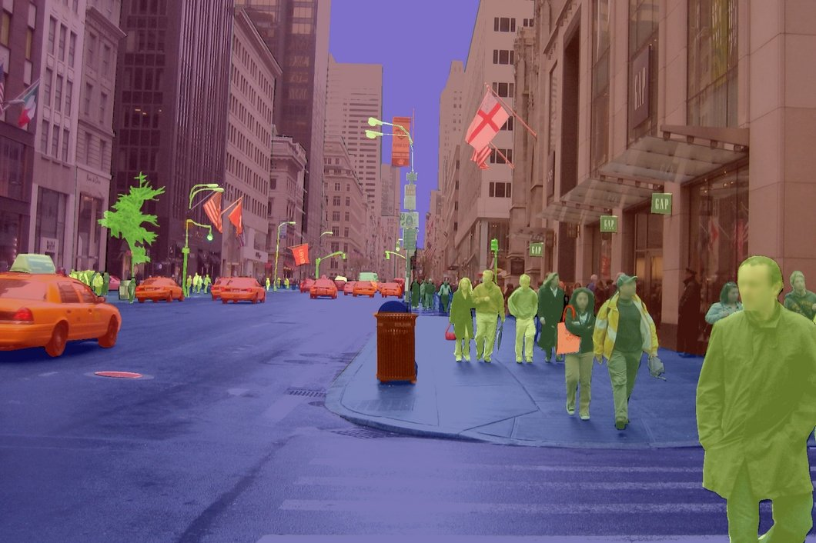
Objectives
Utilizes AI technology such as object segmentation to identify and avoid objects in the streets so as to avoid traffic congestion and accidents.
Implement FCN8s and U-Net models for object segmentation.

Slide 4
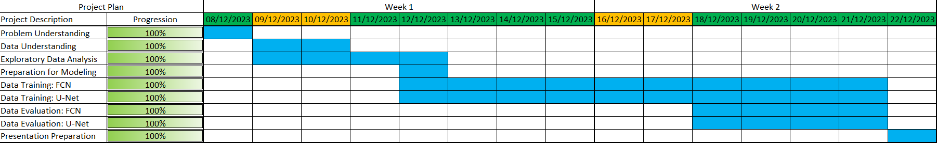
Timeline

Slide 5

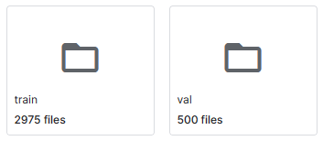
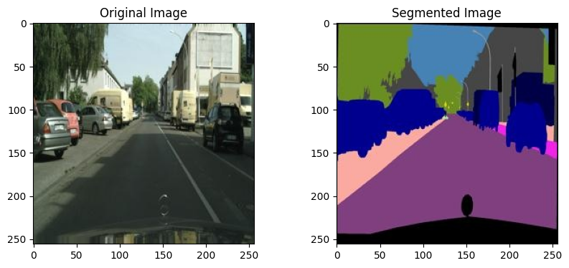

Dataset:
Source Data:
Link1 (Cityscapes Dataset - Original)
Link2 (Cityscapes Image Pairs - Kaggle)
Link3 (Cityscapes Dataset - Dashboard)
Image
Segmented Image
Segmented Image (Grey Scale)

Slide 6
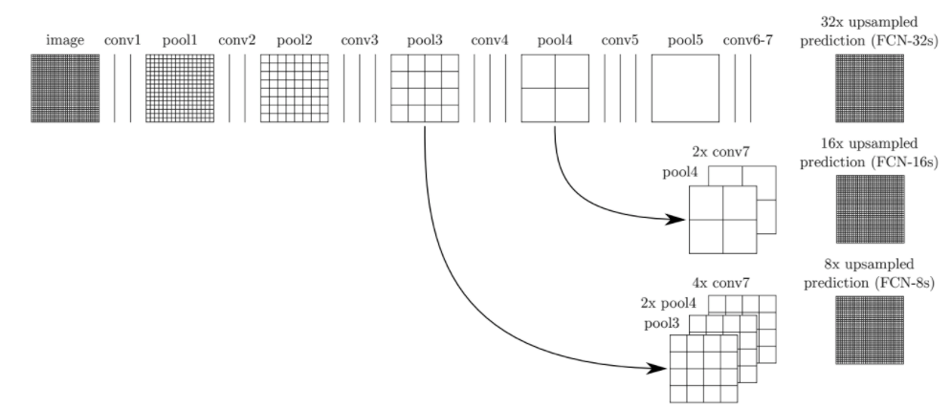
FCN8s Architecture
Backbone CNN : VGG16
Reference: https://www.kaggle.com/code/codelad/fcn-transfer-learning-image-segmentation/notebook

Slide 7
Setting Parameter FCN8s
Setting Training Experiment FCN8s
Width Image : 256
Height Image : 256
Classes : 12
Batch Size : 32
Optimizer : Adam
Loss : Categorical Crossentropy
Metrics : Accuracy
Learning Rate : 0.0001
Weight Decay : 0.01; 0.001; 0.0001; 0.00001
Epochs : 15

Slide 8
FCN8s Training Result
Weight Decay : 0.01
Weight Decay : 0.001
Weight Decay : 0.0001
Weight Decay : 0.00001

Slide 9
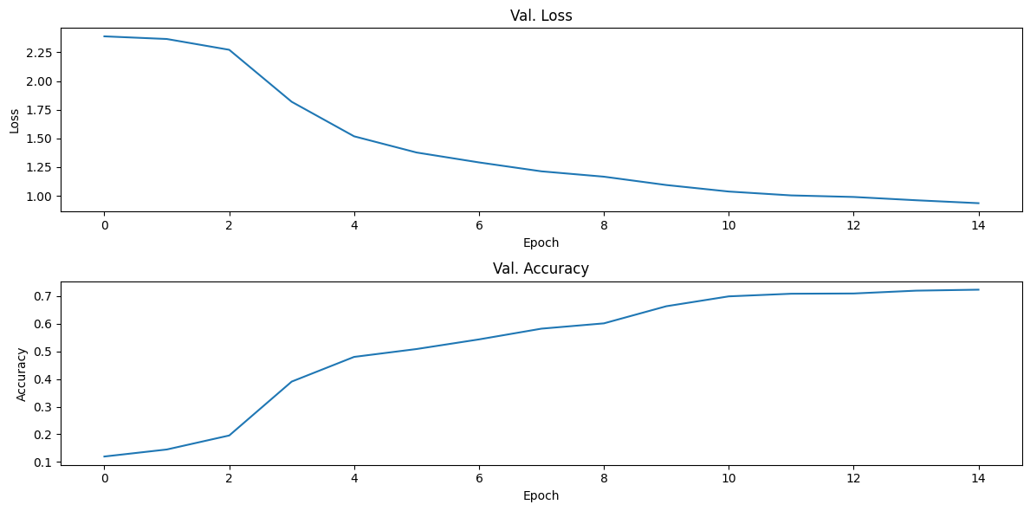
FCN8s Training Evaluation

Slide 10
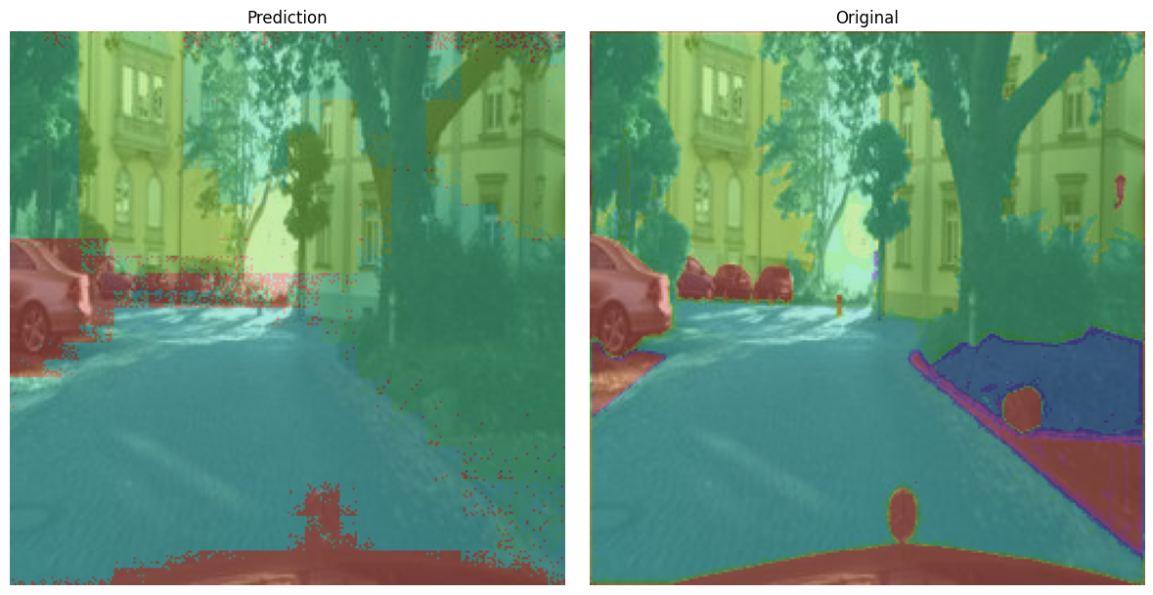
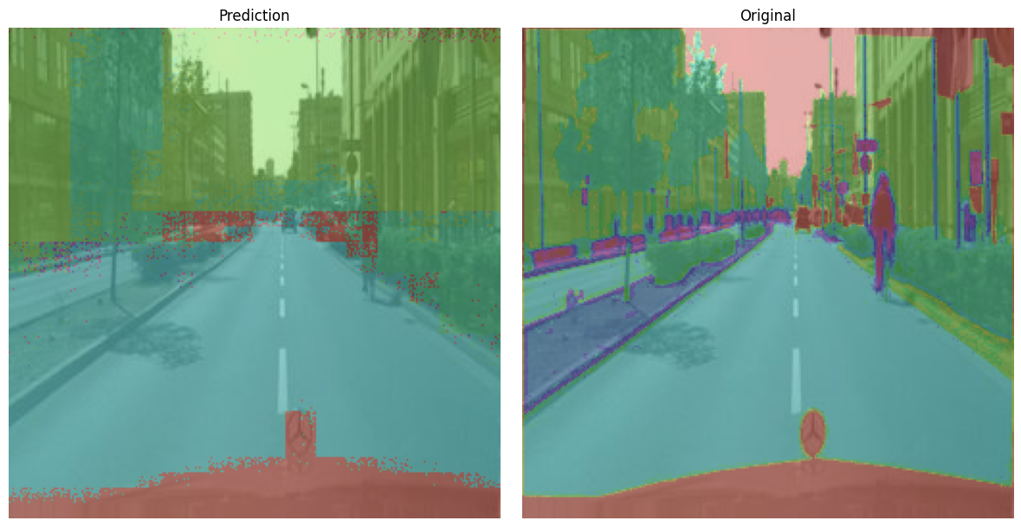
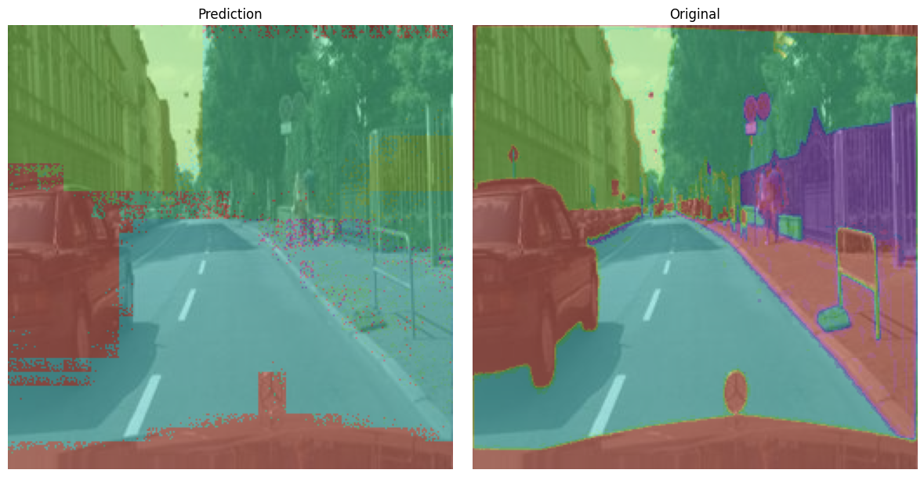
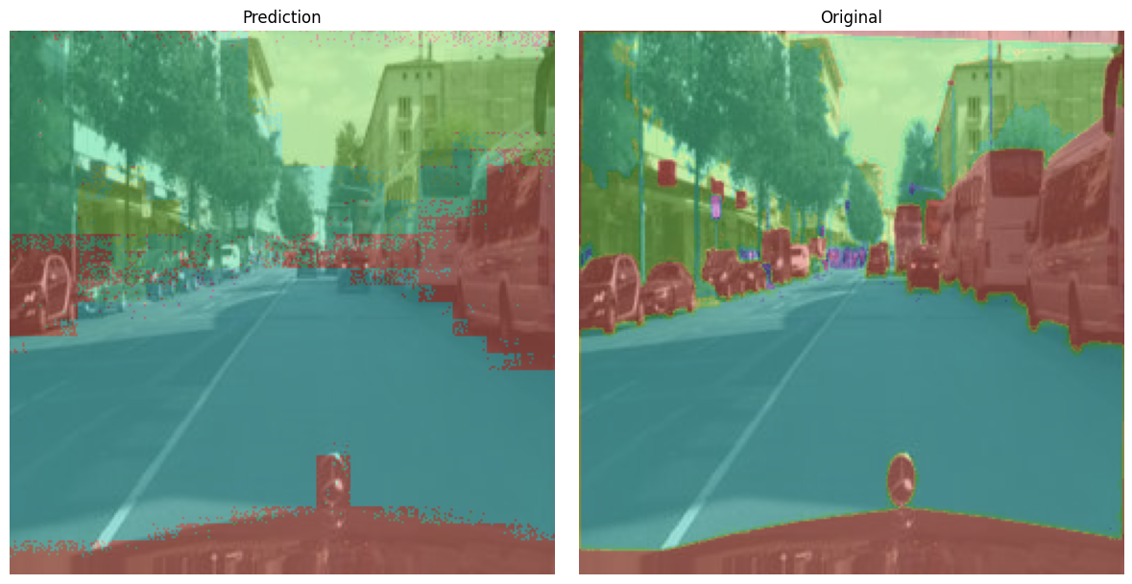
FCN8s Training Evaluation

Slide 11

U-Net
Tiga bagian utama:
Contraction (encoder)
Bottleneck
Expansion (decoder)

Slide 12
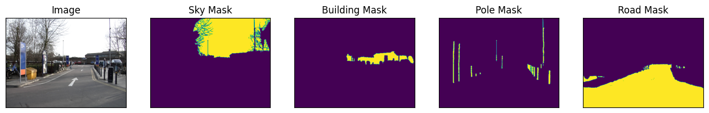
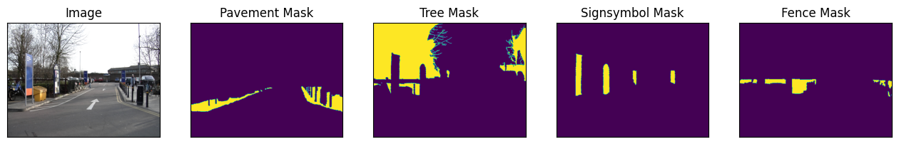
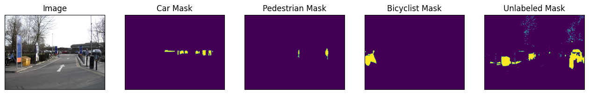
Dataset
367 training data (split to 80/20 training and validation)
101 testing data

Slide 13
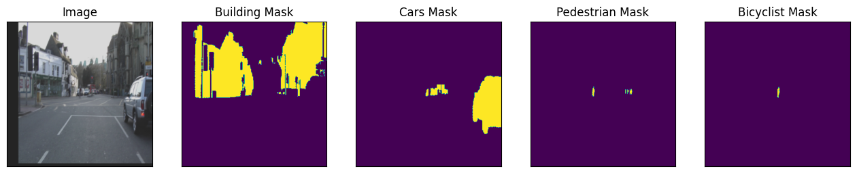
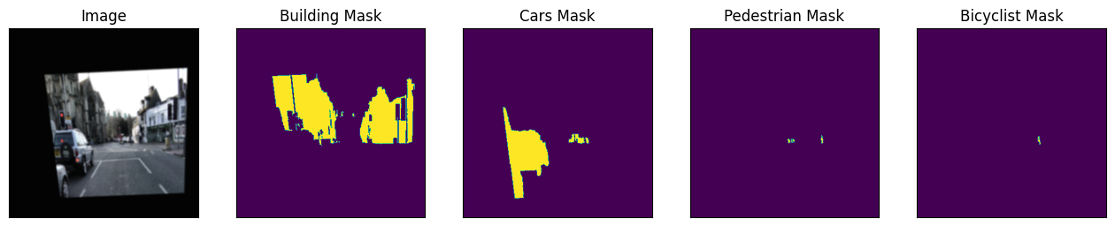
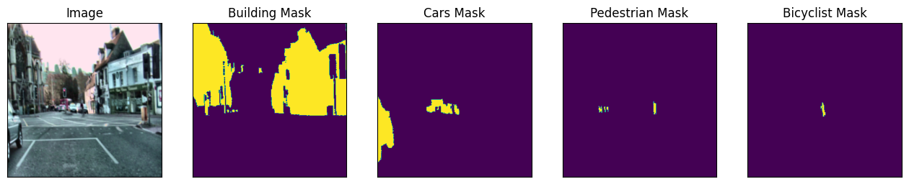
Data Augmentations (Use albumentations):

Slide 14
Training:
Model | UNet (libary: https://github.com/qubvel/segmentation_models.pytorch)
Decoder | resnet34, resnet50, resnet101, efficientnet-b4
Decoder weight | imagenet
Activation | softmax 2d
Learning Rate | 1e-4 (for 0-24 epoch), 1e-5 (for 25-49 epoch), 5e-6 (for 50-74 epoch), 1e-6 (for next epochs)
Metrics | DiceLoss IoU(threshold=0.5) Accuracy
Optimizers | Adam

Slide 15
Training:
classes | encoder | pretrained | epoch | augmention | dice_loss | iou_score | accuracy | training time
12 | resnet34 | no | 50 | yes | 0.2034 | 0.6702 | * | *
12 | resnet34 | yes | 50 | yes | 0.1247 | 0.7869 | * | *
12 | resnet50 | no | 50 | yes | 0.3523 | 0.4832 | * | *
12 | resnet50 | yes | 50 | yes | 0.1197 | 0.8043 | * | *
12 | efficientnet-b4 | yes | 50 | yes | 0.1903 | 0.7236 | * | *
classes | encoder | pretrained | epoch | augmention | dice_loss | iou_score | accuracy | training time
3^ | resnet50 | yes | 50 | yes | 0.9328 | 0.06404 | * | *
12 | resnet34 | yes | 200 | yes | 0.1164 | 0.7969 | * | *
12 | resnet101 | yes | 50 | no | 0.1941 | 0.7617 | 0.9792 | 45.67 min
12 | resnet101 | yes | 50 | yes | 0.1869 | 0.7299 | 0.9749 | 48.64 min
12 | resnet101 | yes | 200 | yes | 0.1154 | 0.8121 | 0.9828 | 192.26 min
* not documented
^3 classes:car, pedestrian, bicyclist

Slide 16
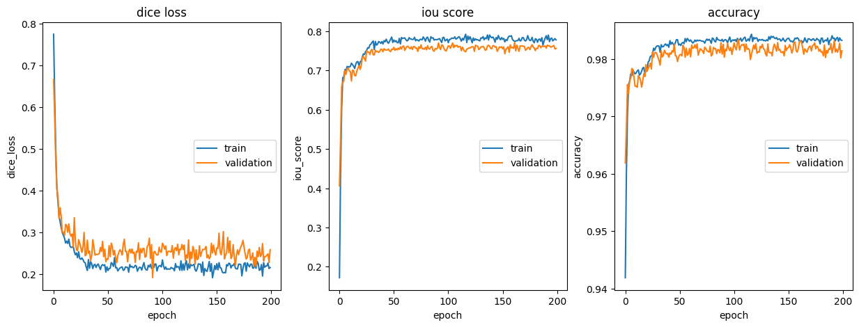
Training:

Slide 17
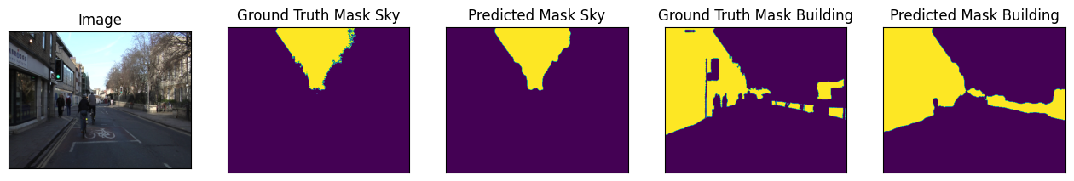
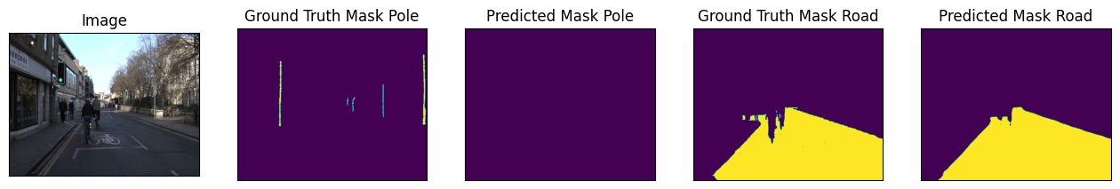
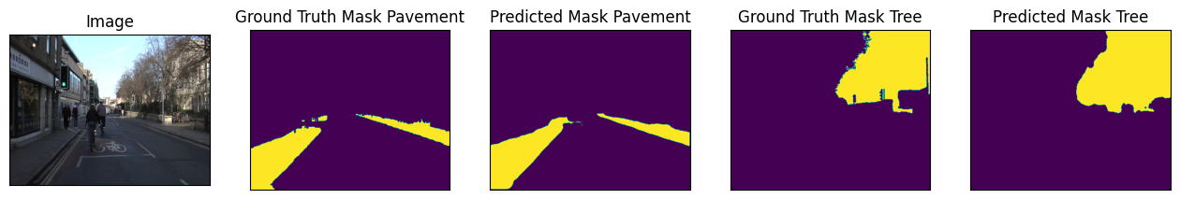
Evaluation:

Slide 18
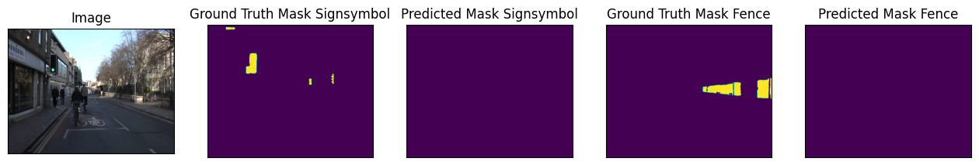
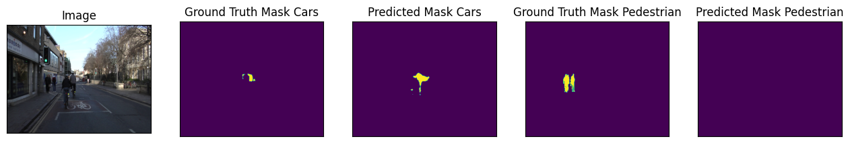
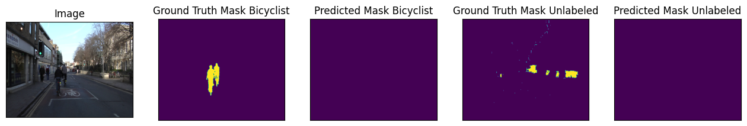
Evaluation:

Slide 19
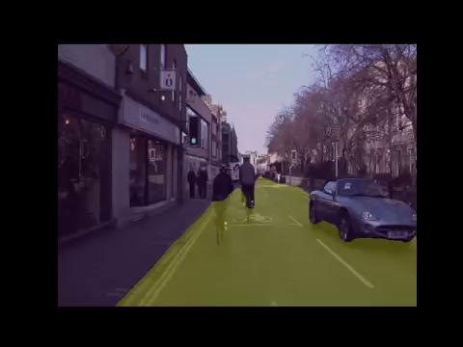
Evaluation:

Slide 20
Comparison: FCN vs U-Net
Model | Classes | Encoder | Pretrained | Epoch | Augmentation | Accuracy | IoU
U-Net | 12 | Restnet101 | Yes | 50 | No | 0.9792 | 0.7617
FCN-8 | 12 | VGG-16 | Yes | 15 | No | 0.7236 | *

Slide 21
Conclusion
FCN8s:
Eksperimen awal didapatkan nilai learning rate yang optimal 0.0001 dan jumlah epochs 15.
Eksperimen selanjutnya memvariasikan weight decay dan optimal pada 0.001.
Dari eksperimen mendapatkan akurasi yang optimal 0.7236.
Hasil evaluasi prediksi gambar menunjukkan bahwa model ini dapat memprediksi segmen object gambar, tetapi hasilnya masih kurang halus, dan masih belum dapat memprediksi object yang kecil, jauh, serta rapat.
Untuk improvement selanjutnya, sebaiknya melakukan eksperimen pada model arsitektur, hyperparameter, dan menerapkan metrik evaluasi yang lebih tepat seperti IoU score dan Dice Loss.
UNet:
Di atas epoch 30 nilai metric sudah tidak banyak berubah (dice loss, IoU score, accuracy)
Setting hyperparameter yang lain (encoder, pretrained, augmentation) juga tidak meningkatkan akurasi segmentasi secara signifikan
Model memiliki nilai accuracy yang tinggi tapi tidak dapat membuat segmentasi untuk objek-objek dengan ukuran kecil
Ketidakmampuan membuat segmentasi untuk objek-objek kecil ini disebabkan kasus imbalance classes (object berukuran kecil memiliki jumlah pixel yang relatif lebih sedikit dibandingkan dengan background-nya)
Saran untuk eksperimen berikutnya: Jumlah data untuk training harus diperbanyak (saat ini hanya mempergunakan 367 data) dan variasinya diperbesar

